Slide 1




Doctor Appointment Booking System Using AI
& Digital Technology
Optimizing Doctor Availability and Appointment Allocation
Page 1

Slide 2

Introduction :
The healthcare industry faces challenges in managing doctor appointments efficiently.
Patients struggle to find available doctors, leading to long waiting times.
This system provides a real-time doctor availability check and automated appointment booking.
Uses AI and digital technology to enhance hospital workflow and patient experience.
Page 2

Slide 3

Problem Statement
Many hospitals still use manual appointment booking, leading to inefficiencies.
Patients don't always know if a doctor is available before visiting the hospital.
Overbooked doctors result in extended waiting times for patients.
No intelligent system to suggest alternative doctors based on availability. and proximity.
Page 3

Slide 4

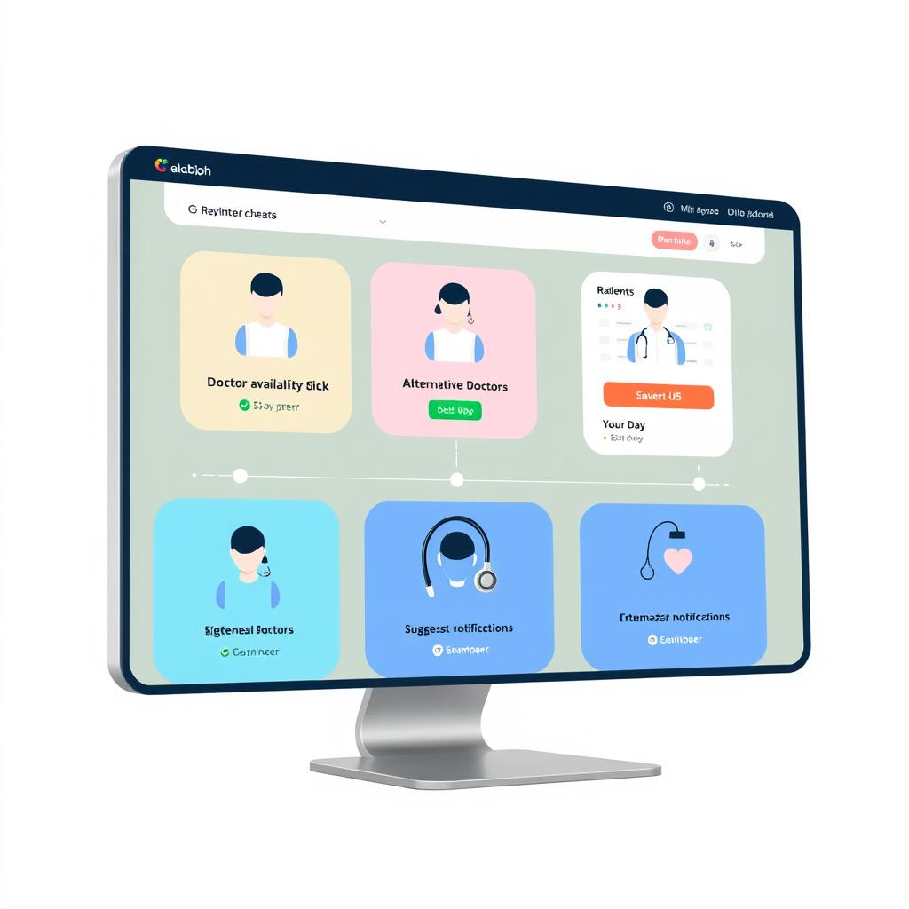
Solution :
A web-based system that:
Providing real-time doctor availability check
Suggesting alternative doctors if the preferred one is unavailable.
Enabling instant online appointment booking.
Sending automated notifications and reminders to patients.
Optimizing doctor schedules with AI-based recommendations.
Page 4

Slide 5

System Workflow:
User Login & Search: The patient logs in and searches for a doctor based on specialization.
Availability Check: The system verifies if the selected doctor is available.
Appointment Booking:
If available → The patient books an appointment.
If unavailable → The system recommends other nearby doctors.
Confirmation & Notification:
The patient receives a confirmation message with appointment details.
Doctor Dashboard:
Doctors can view their schedule and upcoming appointments.
Page 5

Slide 6
Key Features
Real-time Doctor Availability Check – Ensures patients only book available slots.
AI-based Doctor Recommendation – Suggests nearby doctors based on location & specialization.
Automated Appointment Scheduling – Allows easy and efficient booking.
User-Friendly Interface – Simple and interactive UI for patients & doctors.
Doctor Dashboard – Doctors can manage appointments and availability.
Page 6

Slide 7
Frontend :
React (Typescipt) –> Main Frontend framework
Vite → Fast build tool for frontend development
Tailwind CSS → Utility-first CSS framework for styling
Configuration & Build Tools:
ESLint → Code linting
PostCSS → CSS transformations
TypeScript → Strongly typed JavaScript
Technologies used:
Page 8

Slide 8

Thank You
Page 15

